Slide 1
Benefits realisation: a messy affair
Réalisation des bénéfices: une affaire compliquée
18 October 2022

Slide 2

Benefits
A benefit is an outcome of change which is perceived as positive by a stakeholder

Slide 3
Benefits and change management
Enabling change
Business change
Notes:
Enabling changes
Once off
Customer readiness
IT theories include T-|O-E, TAM and UTAMU
Business changes
long-term
Organisational readinesss

Slide 4
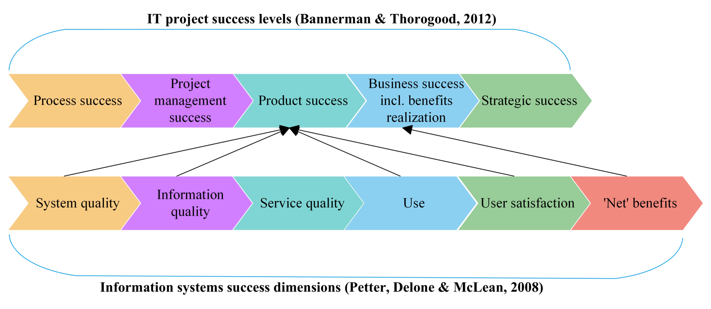
Success Dimensions
Notes:
Before the project
Benefits identification and motivation for the project
During the project (Focus on the product)
Process success focuses on the technical and managerial processes required during a project’s life cycle. Examples are configuration management, quality control and risk management.
Project management success measures time, cost, scope and quality.
Product success relates to the customer since this measurement focuses specifically on ensuring that the project meets the needs of the various stakeholders. Empirical indicators include specifications met, client/user expectations met and product/system used
After the project (Focus on the outputs of the product)
Business success focuses on how projects are used to realise benefits in relation to organisational objectives. Indicators include the validation of the business case and the realization of benefits.
Projects should align with an organisation’s strategy to ensure that strategic success is realised. Increase in market share is an indicator.

Slide 5
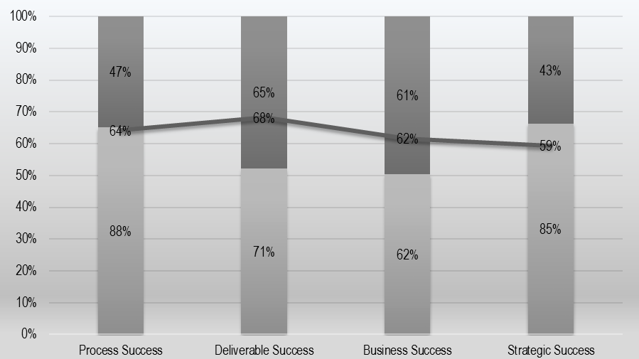
Agile versus Traditional

Slide 6
What are the causes for this mess?

Slide 7
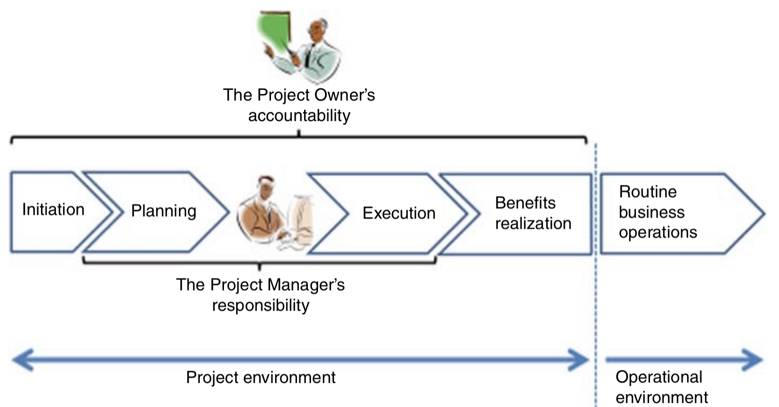
Who’s who in the zoo?
Zwikael, O., Meredith, J. R., & Smyrk, J. (2019)
Notes:
A total of 1,064 respondents completed the survey,
The results indicate that six of the nine roles are of the opinion that the project manager should be responsible for the realization of benefits. Thirty percent of the respondents are of the opinion that the project manager should be responsible for benefits realization. This includes the respondents who are fulfilling a steering committee role. The project managers themselves is of the opinion that they should be responsible for benefits realization at a rate equal to the average among all participants.
Apart from the project manager, the steering committee is also perceived to be responsible for benefits realization. Twenty-six percent of the respondents believe that the steering committee is responsible for benefits realization. Interestingly, the steering committee themselves do not believe that they should be responsible for benefits realization with a mere four steering committee respondents supporting this notion. Fourteen percent of the respondents believe that it is actually the responsibility of the project sponsor to realize the benefits, with 10% of the project managers supporting this belief. Of concern is the 25% of respondents who either do not know who should be responsible or that believe it is no one's responsibility.

Slide 8
Traditional and agile BRM comparison
BRM activities (Holgeid and Jørgensen, 2020; Fernandes and O’Sullivan, 2021) | Traditional BRM | Agile BRM
Identifying and structuring benefits (Focus on benefit activities and outcomes should be defined in terms of benefits to be realised versus functionality of technology) | The business case defines the benefits and how they will be measured (Badewi, 2016). | Pre-investment appraisal to be done before start of project (Holgeid et al., 2021). Re-estimation of benefits and identification of benefits after completion (Holgeid and Jørgensen, 2020). Value streams level introduced by scaling agile (Ebert and Paasivaara, 2017).
Planning benefits realisation (Activities need to realise benefits, including potential organisational and process changes) | Benefits identification, planning and implementation before, during and after project (Cha et al., 2018). Prioritisation of IT projects is done as a once-off exercise (Einhorn et al., 2019). | Benefits identification, planning and implementation are done during a PI planning session of delivery cycles (Petit and Marnewick, 2021b). Prioritisation of IT projects is done at multiple PI planning sessions based on the intended value which enables replanning (Neve, Godbole and Neve, 2017). This is a continuous process throughout the project life cycle.
Execution of benefits realisation plan (Implementation of benefits plan which is integrated with the project management plan. Benefits management goes together with change management) | Benefits realisation and operationalisation normally take place after the project life cycle (Cha et al., 2018). To leverage the business from new IT functionality, a change management process is facilitated in parallel with project processes. Change management is a separate process, although the project deliverable impacts the change (Doherty, 2014; Badewi, 2016). | Change is managed through continuous prioritisations, iterative planning using project vision and backlogs (Lappi et al., 2018). Continuous value delivery (Holgeid and Jørgensen, 2020). The PI planning sessions are used to continuously evaluate the intended value of a project (Petit and Marnewick, 2021b).
Sustainment (Evaluation of benefits delivered and identification of actions to receive missed benefits) | Long-term post-project benefits realisation (Lappi et al., 2018). | Short-term value realisation through the utilisation of deliverable from short delivery cycles (Lappi et al., 2018).

Slide 9

Lack of knowledge is darker than night African Proverb

Slide 10

Cleaning up the mess

Slide 11


Rule-based versus Principle-based
Notes:
What is the difference between a rules-based and principle-based approach to regulation?
A rules-based approach to regulation prescribe in detail or gives a set of rules, how to behave whereas a principle-based approach to regulation outcomes and principles are set and the controls, measures, procedures on how to achieve that outcome is left for each organisation to determine.
Let me illustrate using a simple example of how driving under the influence of alcohol will be regulated in each dispensation.
A rules-based approach: “In South Africa, the legal limit for blood alcohol level is 0.05g per 100ml whilst driving” There is a clear rule on how to behave when drinking and driving.
Principle-based approach: “Please consume alcohol responsibly before driving on public roads.” The outcome is clear, namely responsible driving on the roads, but the manner in which to achieve this is left open for interpretation.
Benefits
Flexibility on how outcomes or principles are achieved or implemented
Key decisions with regards to regulations will be made by more senior level employees
Proportional to the size and complexity of the organisation
Risk-based
Challenges
Inconsistent approach to implementation
Uncertainty about how the regulator will view conduct, measures and controls;
Ongoing justification and recording the reasoning behind conduct or measures
Requires more skills to develop measures that will meet the outcome or principle
Principles may be too broad

Slide 12
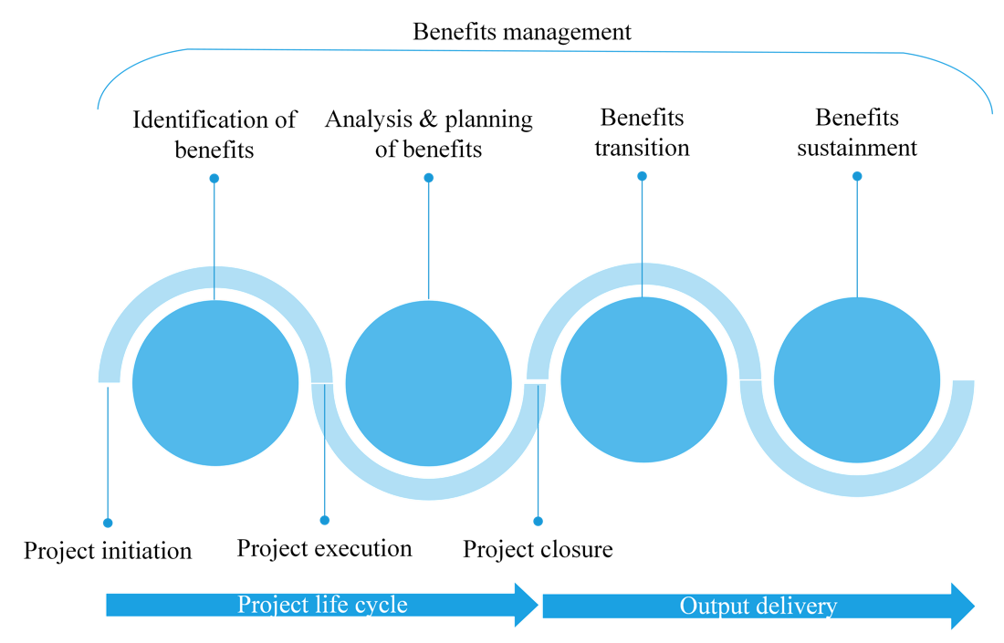
Rule-based BRM

Slide 13
Principle-based BRM

Slide 14

Decision-making
Pragmatic
Takes a practical approach to the consideration of benefits realisation in project management. They are not strongly self-motivated for benefits realisation, but will consider it when they see a good application for benefits realisation
Intrinsically Motivated
Address benefits realisation because they care about the long-term success of the project.
Task Driven
Consider benefits realisation when it is part of the project’s requirements or objectives, when the client asks for it or when they are rewarded for it

Slide 15
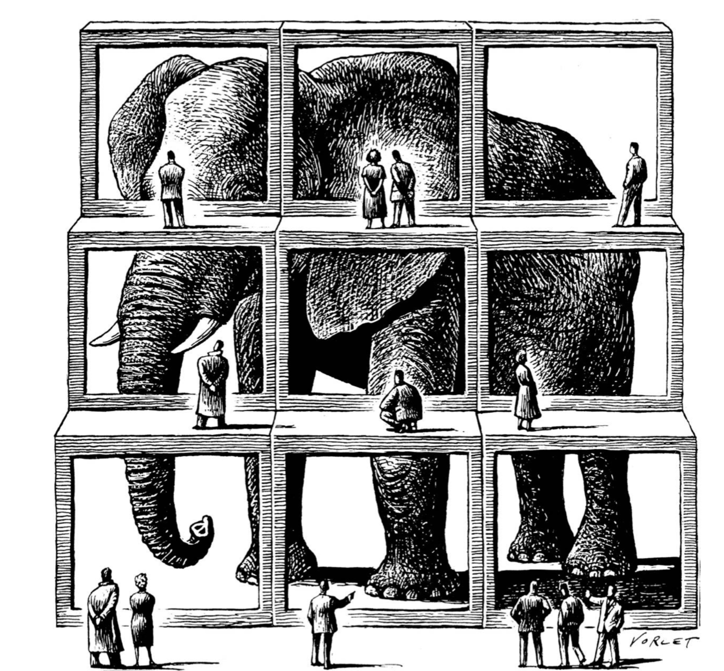
Context
Notes:
The results clearly indicate that there is still confusion around who is responsible for BRM and who should be the owner of the benefits. This is in line with the analysis of the literature. Future research can focus on the influence of the environment on BRM. Future research can investigate environmental aspects such as the type of organisation, the type of projects, the locality of the organisation as well as the characteristics of the project and the organisation. BRM ownership and responsibility have been investigated from a general perspective but never from a specific perspective to determine whether environmental aspects influence BRM ownership and responsibility. Context is everything.
Further research an also be done on the categorisation of benefits. Will the categorisation of benefits influence BRM ownership and responsibility. Again, context is everything.

Slide 16

Questions

