Slide 1
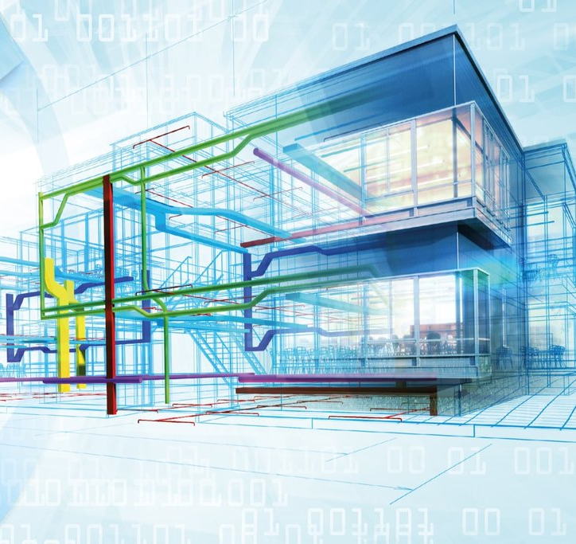
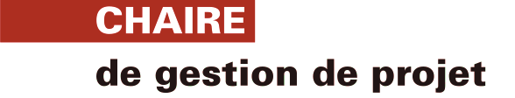
Transformation numérique par le BIM : identification des avantages et des désavantages perçus en conception de projet
Xavier Morin, Alejandro Romero-Torres, Marie-Pierre Leroux and Caroline Coulombe
Novembre 2022

Slide 2

Ordre de la presentation
Contexte de la recherche
Objectif
Cadre conceptuel
Methodologie
Résultats
Discussion et conclusion

Slide 3

Contexte de la recherche : outils numériques, utilisation du BIM et la collaboration en amont du projet.
BIM is a set of "parametric tools and processes for the creation and maintenance of an integrated collaborative database of multidimensional information regarding the design, construction and operations of a building, with the purpose of improving collaboration between stakeholders [...]" (Fazli & al, 2014, p. 1117).
Notes:
These technologies have the potential to revolutionize economy by moving from a hyperconnected world to one of digitalized industries and societies..
This new processing capacity can quickly integrate, store, and present a large amount of data to facilitate decision-making among a set of alternatives,
Building Information Modelling (BIM) enables collecting, preparing and analyzing data, with a view to fostering collaboration throughout the life cycle of construction projects. BIM is then transforming project delivery, including their conception where stakeholders’ collaboration for making decision is a key factor for defining project objectives and scope. BIM can collect data related to deliverable configuration and progress, enabling digital models to conceive, plan and monitor the project and its deliverable progress.
a structured BIM-enabled collaborative design process can improve multidisciplinary communication, and thus, assist in achieving sustainability objectives more efficiently. BIM support information exchange since the " the visualization of the design alternatives through BIM helps project participants review the design alternatives easily. In addition, the integration of data included in the BIMs from different disciplines enables the quick and accurate extraction of information

Slide 4
Contexte de la recherche: outils digitaux, l’utilisation du BIM, la prise de decision et la gestion des parties prenantes
Outils digitaux et utilisation du BIM
Collaboration lors de la conception
Les données fournies par ces technologies numériques ont un fort potentiel pour mieux comprendre et maîtriser les défis du projet et créer plus de valeur (Pan et Zhang, 2021).
En offrant divers ensembles de données liés au projet et au livrable, le BIM encourage l'implication des parties prenantes issues de différents domaines d'expertise (Zanni, Ruikar, & Soetanto, 2020).
L'utilisation croissante des outils numériques nécessite de revoir les pratiques et d'actualiser les compétences et les aptitudes des équipes de projet (Poirier, Forgues, & Staub- French, 2017).
Il est impossible pour les décideurs de répondre à tous les besoins et préoccupations des parties prenantes (Winch, 2013).
La phase de conception doit viser à obtenir un consensus sur l'interprétation du projet grâce à l'engagement et à la collaboration des parties prenantes. Si ce n'est pas le cas, la complexité de la conception peut être accentuée (Priemus, 2008).
Sörenson (2005) souligne que les solutions du projet ne correspondent généralement pas aux besoins du projet parce que les parties prenantes ont été négligées ou que le besoin initial du projet a été formulé de manière inadéquate (Priemus, Flyvbjerg et van Wee, 2008).
Les technologies numériques refondent les relations entre les parties prenantes car elles peuvent toutes partager des données pour soutenir le processus de prise de décision (Wu, 2021).
Avec l'introduction des nouvelles technologies dans la gestion de projet, certaines parties prenantes ne sont pas en mesure de comprendre pleinement les tenants et aboutissants de la transformation numérique (Olsson et Bull-Berg, 2014).
Le BIM transforme l'exécution et la conception des projets (Whyte, 2019).
Notes:
With the introduction of new technologies in project management, some stakeholders are not able to fully understand the ins and outs of the digital transformation.
Challenges : role and responsibility redefinition, technical capability needs, and variations in BIM model interpretations. Project managers must be aware of these issues if they wish to realize these benefits. The implementation of BIM does not easily fit within a project management framework and requires a more flexible, informal, team-based collaborative approach
t’s noticed that this collaboration is difficult to achieve due to the ambiguity among actors involved in the project. Some of them experience a lack of knowledge towards their new roles, creating pitfalls for tasks coordination and collaboration
-----------------------------------
Savoir l’effets des données relations des parties prenantes + pourquoi on focus sur le front end et pourquoi c’est important

Slide 5

Objectif
Comprendre comment les acteurs impliqués dans les projets de construction perçoivent l'utilisation du BIM pendant la phase conception. Plus précisément, nous avons cherché à identifier les changements liés à l'utilisation de la BIM pendant cette phase.

Slide 6
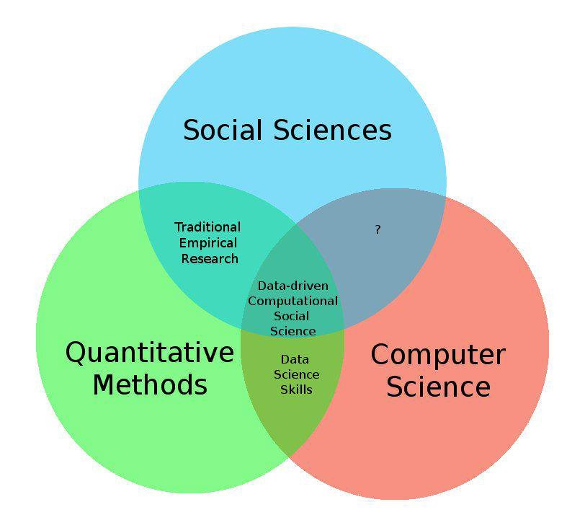
Cadre conceptuel: Sciences sociales informatiques
Un domaine d'étude qui "applique des méthodes informatiques à de nouvelles sources de données numériques telles que les médias sociaux, les dossiers administratifs et les archives historiques pour élaborer des théories sur le comportement humain" (Edelmann, Wolff, Montagne et Bail, 2020, p. 62).
" Les grands ensembles de données qui décrivent le fonctionnement interne de systèmes sociaux complexes [...] ne peuvent être compris de manière adéquate à partir d'une seule perspective disciplinaire " (Chang, Kauffman, & Kwon, 2014, p. 71).
Notes:
Since project management is related to theories from social sciences and BIM comes from computational sciences, we combine both types of theory to better understand impacts and benefits related to BIM in project conception
New social science perspectives introduced by combining social and computational sciences enable understanding about how actors adapt their organizational culture and changed their roles and responsibilities to understand and undertake activities using new digital tools
achieve such synergy between IT and managerial skills, collaboration between executives, employees, and other stakeholders, as well as coordination of their responsibilities, is necessary beforehand
Due to the evolving context of digital transformation, actors must continually adjust their practices and competencies
, these new processes do not occur within a single organizational silo. Instead, many actors and organizations must collaborate and partner to acquire the resources and data analysis capabilities
Computational social sciences provide a theoretical perspective to frame this research. This perspective permits to juxtapose several disciplines and domains of knowledge from the social and computational sciences
To properly answer our research question, it is essential to highlight and distinguish perspectives of each discipline. By adopting the disciplinary cross-pollination approach exemplified by the computational social sciences, issues surrounding BIM perceptions by project actors can be analyzed and presented according to the context in which the stakeholders perform their roles ------
-------------------------------------
Faire de le lien computational = BIM / Social Sciences = Partie prenantes

Slide 7

Methodologie
Notes:
A qualitative exploratory approach was found to be appropriate, as it provides a deeper description and understanding of the experiences and interpretations of actors involved in a construction project where BIM is used. We opt for the case study approach because it allows us to analyze a phenomenon in its context by bringing out the most significant and influential concepts.
A multiple case study was chosen to get a thorough understanding of a phenomenon under-explored in the literature: impacts of digital tools in project management (Guinan, Parise and Langowitz, 2019). A multiple case study employing a wider variety of data ensures a broader exploration of the research question (Eisenhard & Graebner, 2007
This approach is also appropriate when there is little information surrounding the phenomenon under study, thus echoing the exploratory aspect of this research.
Commencer par études de cas – ensuite pour les entrevues semi structured

Slide 8
Étude de cas
Charactéristiques | Projet A | Projet B
Type d’infrastructure | Hôpital | Hôpital
Type de projet | Modernisation et mise à niveau | Modernisation et mise à niveau
Budget | $ 225 million CAD | $ 260 million CAD
Durée de la conception | Février 2016 à Juin 2018 | Avril 2019 à Mars 2021
Durée de la construction | Juin 2018 à Décembre 2022 | Mas 2021 à 2025
Maturité du BIM perçu | Élevé | Élevé
Les transcriptions des entretiens ont été importées dans NVivo pour une analyse qualitative. Le cadre de catégorisation des données recueillies était de nature technique, car nous voulons comprendre les effets du BIM dans les pratiques de gestion de projet. Dans un premier temps, les verbatim ont été codés afin de faire ressortir certains thèmes. Par souci de précision et de concision, les verbatim ont été codés deux fois.
Notes:
For this research, the selected cases are two construction projects (project A and B) being managed by a public agency in North American, as presented in Table 2. These two projects were selected because they have used BIM to support project conception, and both are already in execution.
The organization managing both projects under study is a Crown corporation that supports public organizations in managing infrastructure projects. Based on this mission, its employees support projects with their expertise and tools to conceive, plan, implement, monitor and operate projects.
This institution is also mandated by government to maintain and manage a public real estate portfolio to be able to deliver governmental services to citizens, including healthcare, education and justice.
Project A aims to construct, redevelop, expand and consolidate various sectors of a hospital in North America. It was modernization and upgrade of a building built in the 1950s
Project B is a construction, redevelopment, expansion and consolidation project of various healthcare units in a hospital
---------------------------------
Analyse thématique sur Nvivo ajouter dans le power point

Slide 9
Participants
Participant | Rôle | Années d’experience en gestion de projet | Years of project management experience | Années d’experience BIM | Niveau de maturité BIM
Project A
1A | Gestionnaire de projet |  | 20 | 7 | Medium
2A | Coordinateur BIM |  | 7 | 7 | Haut
3A | Architecte |  | 40 | 5 | Bas
4A | Architecte |  | 7 | 7 | Medium
5A | Représentant du client |  | 3 | 3 | Bas
6A | Ingénieur en chef |  | 20 | 10 | Haut
Project B
1B | Ingénieur |  | 13 | 1 | Bas
2B | Coordinateur BIM |  | 5 | 5 | Haut
3B | Ingénieur |  | 5 | 3 | Medium
4B | Représentant du client |  | 6 | 3 | Bas
5B | Directeur du projet |  | 3 | 3 | Bas
6B | Coordinateur BIM senior |  | 12 | 12 | Haut
Notes:
Data was mobtained by individual interviews and, more specifically, semi-structured interviews. Semi- structured interview allows comparability of results between participants. All interviews were performed during summer 2021.
We used an interview guide with open-ended questions to get participants to describe their perspectives and experiences with the use of BIM during the conception of construction projects. First section included questions to identify participant characteristics and the following sections focus on identifying subjective experiences to better understand how actors interact with BIM and to what extent this technology influences their functions, decisions and interrelations. The interviews lasted from 45 to 60 minutes.
The individuals selected met certain criteria specific to the study population, which were: i) the individual must be involved in the selected construction project where BIM is used, ii) the individual must be involved in a collaborative decision-making process where the information provided by BIM is used as a decision-making input for conception phase, iii) the individual must understand the operation and utility of BIM, and iv) the individual must work with other stakeholders during the conception phase.
In total, twelve interviews were completed: six interviews for each case. Interview transcriptions were imported into NVivo for qualitative analysis. The framework for categorizing collected data was technical in nature, as we want to understand the effects of BIM in project management practices.
by selecting six stakeholders occupying different roles in each project, it helps us understanding relationships among them and how BIM comes to influence the conception of a construction projec
First, verbatim were coded to highlight certain themes. For precision and conciseness purposes, verbatim were coded twice. Once initial themes were established, researchers defined them and added segments of verbatim as the categorization progressed. Using this approach, a common thread is built among participants, so that it is more evident to understand the nuances brought by each actor and to highlight the pathway leading to the explanation of the phenomenon
-------------------
Le temps des entrevues

Slide 10
Résultats principaux : impacts sur la gestion des parties prenantes
Redéfinition des rôles et responsabilités
"Il y a encore un flou autour des responsabilités et de ce qui est demandé à chacun". (5A)
" Avec les ateliers de coordination BIM, toutes les parties prenantes sont présentes ; nous collaborons tous ensemble sur un problème " (2A).
" Avec le BIM, nous avons pu faire une démonstration au début du projet. C'était notre principal outil de communication " (5B)
Développement de l’expertise et des compétences interpersonnelles
Supporte le transfert de savoir et la communication
"Il y a tellement d'éléments dans un projet. On ne peut pas tout mettre dans un modèle et ensuite faire des séances d'interférence avec tous les éléments." (1B)
" Au début de la modélisation, il faut savoir qui est chargé de résoudre les interférences de tel ou tel élément avec tel ou tel autre. "(3B)
Accroissement du temps et de l’effort
Collaboration de plus en plus complexe

Slide 11
Résultats principaux : impacts sur la prise de décision collaborative
« L’information, je pense que c’est le principal enjeu dans la prise de décision et le BIM apporte un meilleur accès à cette information-là. » (2A)
Différents niveaux de compréhension des informations du BIM
Disponibilité et visualisation de l’information
« Pour prendre des décisions en fonction des maquettes du BIM, il faut bien connaître l’outil de travail bien sûr. J’ai trouvé que ce n’était pas le cas pour la majorité des usagers. » (2B)
Décisions préventives et vérification de l’impact des décisions
« Ça nous permet de venir faire une première vérification pour voir si cette décision ou ce changement-là va impliquer des choses trop importantes de leur côté. » (3B)

Slide 12
Bénéfices et incovénients perçus
Bénéfices perçus
Facilite le transfert du savoir entre les parties prenantes.
Hausse de la transparence entre les parties prenantes impliqués dans la conception.
L’utilisation du BIM augmente la communication entre les parties prenantes
Inconvénients perçus
La portée de la conception augmente, sans ajustement dans le temps.
Redéfinitions des rôles et responsabilités pour certains professionnels.
Exigences irréalistes pour la conception de projet.
La représentation numérique des infrastructures physiques et techniques donne lieu à un partage des données de conception entre les parties prenantes, tant au niveau organisationnel qu'au sein de l'équipe de projet (Fazli et al, 2014). Winch (2013) affirme que dans les projets de construction, de nombreux comportements opportunistes proviennent d'un manque de transparence ou d'informations incomplètes. Le BIM a le potentiel de réduire certains de ces risques moraux.
En ne définissant pas les rôles et les responsabilités, les organisations n'optimisent pas pleinement leurs technologies (Janssen, van der Voort, & Wahyudi, 2017) et notre recherche démontre que l'utilisation du BIM est conditionnée par le contexte social dans lequel la technologie est exploitée, et ce contexte est en même temps façonné par le processus de communication et de coordination entre les parties prenantes (Murphy, 2014).
Notes:
Evidence reveals that BIM creates beneficial effects of BIM on knowledge transfer and communication between stakeholders. Indeed, professional concentration around the same model allows them to become familiar with other disciplines and to share project knowledge. Computational social sciences suggest that organizational adjustments caused by the introduction of 4th Industrial Revolution tools require coordination of all disciplines involved. Consequently, professionals must explore various perspectives offered by this diversity of disciplines
Allowing professionals to better understand other disciplines and expertise, BIM seconds multidisciplinary and helps stakeholders understanding interrelationships between them. In other words, with BIM, stakeholders are better able to grasp the scope of the project and contextualize it through the exploration of different perspectives. This is consistent with the writings of Morris (2013) who proposes that when managing a project, the focus should be on the context of the project.
Knowledge transfer enabled by BIM also increases transparency among professionals involved in project conception. Indeed, by having access to professional knowledge, actors can easily follow and understand project conception
Both cases reveal that BIM increases communication between stakeholders. However, to achieve communication efficiency it is imperative to rethink and revaluate work methods. Indeed, no information is lost with BIM, and professionals can track it and communicate it to relevant stakeholders
With this visual representation, actors quickly make decisions based on model data, which improves the flow of work activities and staff alignment, while allowing for adjustments based on new data captured in real time to deliver a building conception with the least amount of interference (Pan and Zhang, 2021).
----------------
------------
conception objective and scope increase since problems and interference can be identifying before project construction. By giving insufficient time to project conception, interferences between disciplines can be exposed. However, adding time to this phase is difficult for the project owner to accept, as initial estimation for schedule and cost will not be met. In this regard, Nisar et al. (2020) point out that desired benefits of collecting, processing and data are only attainable through the implementation of a management framework that allows for proper handling of these information assets. In addition, one of the reasons that the conception time is not yet adjusted is that some stakeholders, including the project owner and other disciplines, such as structural, architectural and various general contractors, have inadequate visibility into the real benefits
BIM use also results in a redefinition of roles and responsibilities for certain professionals, as described by Sebastian (2011). However, some disciplines are not adapting as well as others to changes caused by BIM in project conception. BIM use requires all involved actors have a sufficiently high level of technical capacity and commitment. Nevertheless, a low level of adaptation to BIM leads to pitfalls in the coordination of activities during project conception (Sebastian, 2011) and this is precisely what participants describe in our research.
However, there is not a clear process or guideline to do it. Actors must then negotiate to define prioritization, creation some frictions among them. This is in contradiction to Wang and al. (2016) that show data visualization and management technologies, such as BIM, improve relationships between stakeholders through better collaboration and communication. To avoid conflicts, stakeholders need to cooperate to move towards a shared understanding of the information emerging from digital modelling
hus, in the absence of a structure surrounding the resolution of inferences, some stakeholders observe BIM can cause potential challenges during negotiations. This conflict issue illustrates effects of the Fourth Industrial Revolution where digitization of work leads to a reorganization of interactions between the different professionals involved
Other disbenefits related to BIM use is unrealistic requirements for the project conception. Indeed, both cases show that expectations from some stakeholders are disconnected from the real context of the project
------------------------------

Slide 13
Disparités entre les acteurs
L'ingénieur en chef (6A), le chef de projet (1A) et le responsable du client (5A) ont des rôles transversaux de coordination et d'arrimage, ce qui signifie qu'ils collaborent avec une multitude de professionnels issus d'un large éventail de disciplines. Par conséquent, ils sont plus susceptibles de remarquer les effets de la BIM, tant positifs que négatifs, sur les autres parties prenantes.
L'ingénieur (1B) est responsable des plans d'ingénierie structurelle. Bien qu'il participe aux réunions statutaires, il est moins susceptible d'interagir avec des professionnels ayant des responsabilités importantes. En revanche, le coordinateur BIM senior (6B) perçoit que les effets négatifs de l'utilisation de la BIM sont bénéfiques à long terme, car elle peut augmenter la précision de la productivité pour la conception du projet.
Cet exemple met en lumière l'étude de Forsythe, Sankaran et Biesenthal (2015) où ils concluent que le BIM, ainsi que les avantages qui en découlent, sont bien mieux adaptés à certaines disciplines qu'à d'autres.

Slide 14
Contributions pratiques
La redéfinition des rôles et responsabilités en amont est un facteur critique influençant l’atteinte des bénéfices envisagés de l’utilisation du BIM.
Cette réorganisation requiert que les professionnels aient préalablement des connaissances et compétences adéquates afin de bien remplir leur nouvelles responsabilités.
L’adéquation des exigences des parties prenantes influence grandement les relations que celles-ci entretiennent

Slide 15

Conclusion : Pour obtenir des résultats positifs de l'utilisation de la BIM, les organisations et les acteurs impliqués dans la conception du projet doivent mettre à jour leurs pratiques de conception, changer la culture organisationnelle, développer les compétences interpersonnelles et d'équipe et augmenter la visibilité des avantages de la BIM.
Contributions :
Les résultats générés par cette recherche donnent un aperçu des impacts des outils numériques dans la gestion de projet, en particulier pour le cycle de vie du projet. Cette recherche contribue également à identifier les acteurs qui ont tendance à être plus affectés par le BIM dans la phase de conception.

